Slide 1
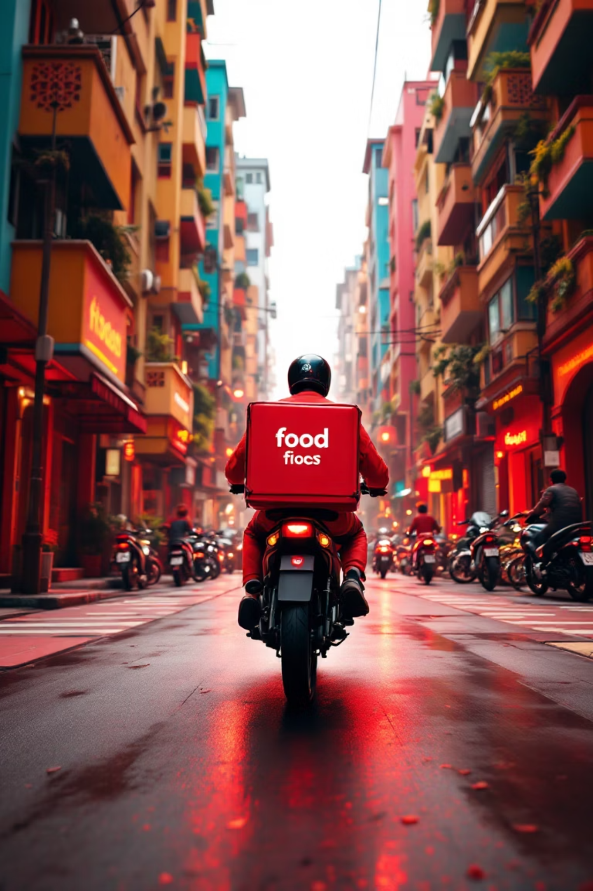
Zomato Delivery Partner Dashboard
Created by: Dinesh Sivakumar | Data Analytics & Business Intelligence Specialist

Slide 2

Project Vision & Impact
Our Mission
Transform raw delivery data into actionable insights that empower operations teams and delivery partners across Tamil Nadu's bustling food delivery ecosystem.
Core Objectives
Analyze delivery partner performance across critical KPIs
Uncover patterns in delays, fees, and customer satisfaction
Identify optimization opportunities by vehicle type and area
Drive data-informed decisions with local context

Slide 3





Technology Stack & Data Pipeline
Power BI
Interactive dashboards with real-time filtering and drill-down capabilities for comprehensive
data exploration
DAX Calculations
Advanced metrics including delivery efficiency ratios, time-based aggregations, and performance scoring
Data Sources
Excel and CSV files containing delivery transactions, partner profiles, and customer feedback data
Python Integration
Data preprocessing, cleaning, and transformation to ensure data quality and consistency

Slide 4
Delivery Ecosystem at a Glance
A comprehensive snapshot of Zomato's delivery operations reveals the scale and complexity of our network across Tamil Nadu's urban centers.
500
78K
4.2
₹45
Active Partners
Total Deliveries
Average Rating
Median Fee
Dedicated delivery professionals
Orders completed successfully
Customer satisfaction score
Per delivery transaction
Primary Vehicle Type
Focus Area
Motorcycles dominate with 85% of deliveries, offering the perfect balance of speed and maneuverability through Chennai's busy streets.
Adyar leads in delivery volume, representing 22% of all orders across our operational zones.

Slide 5
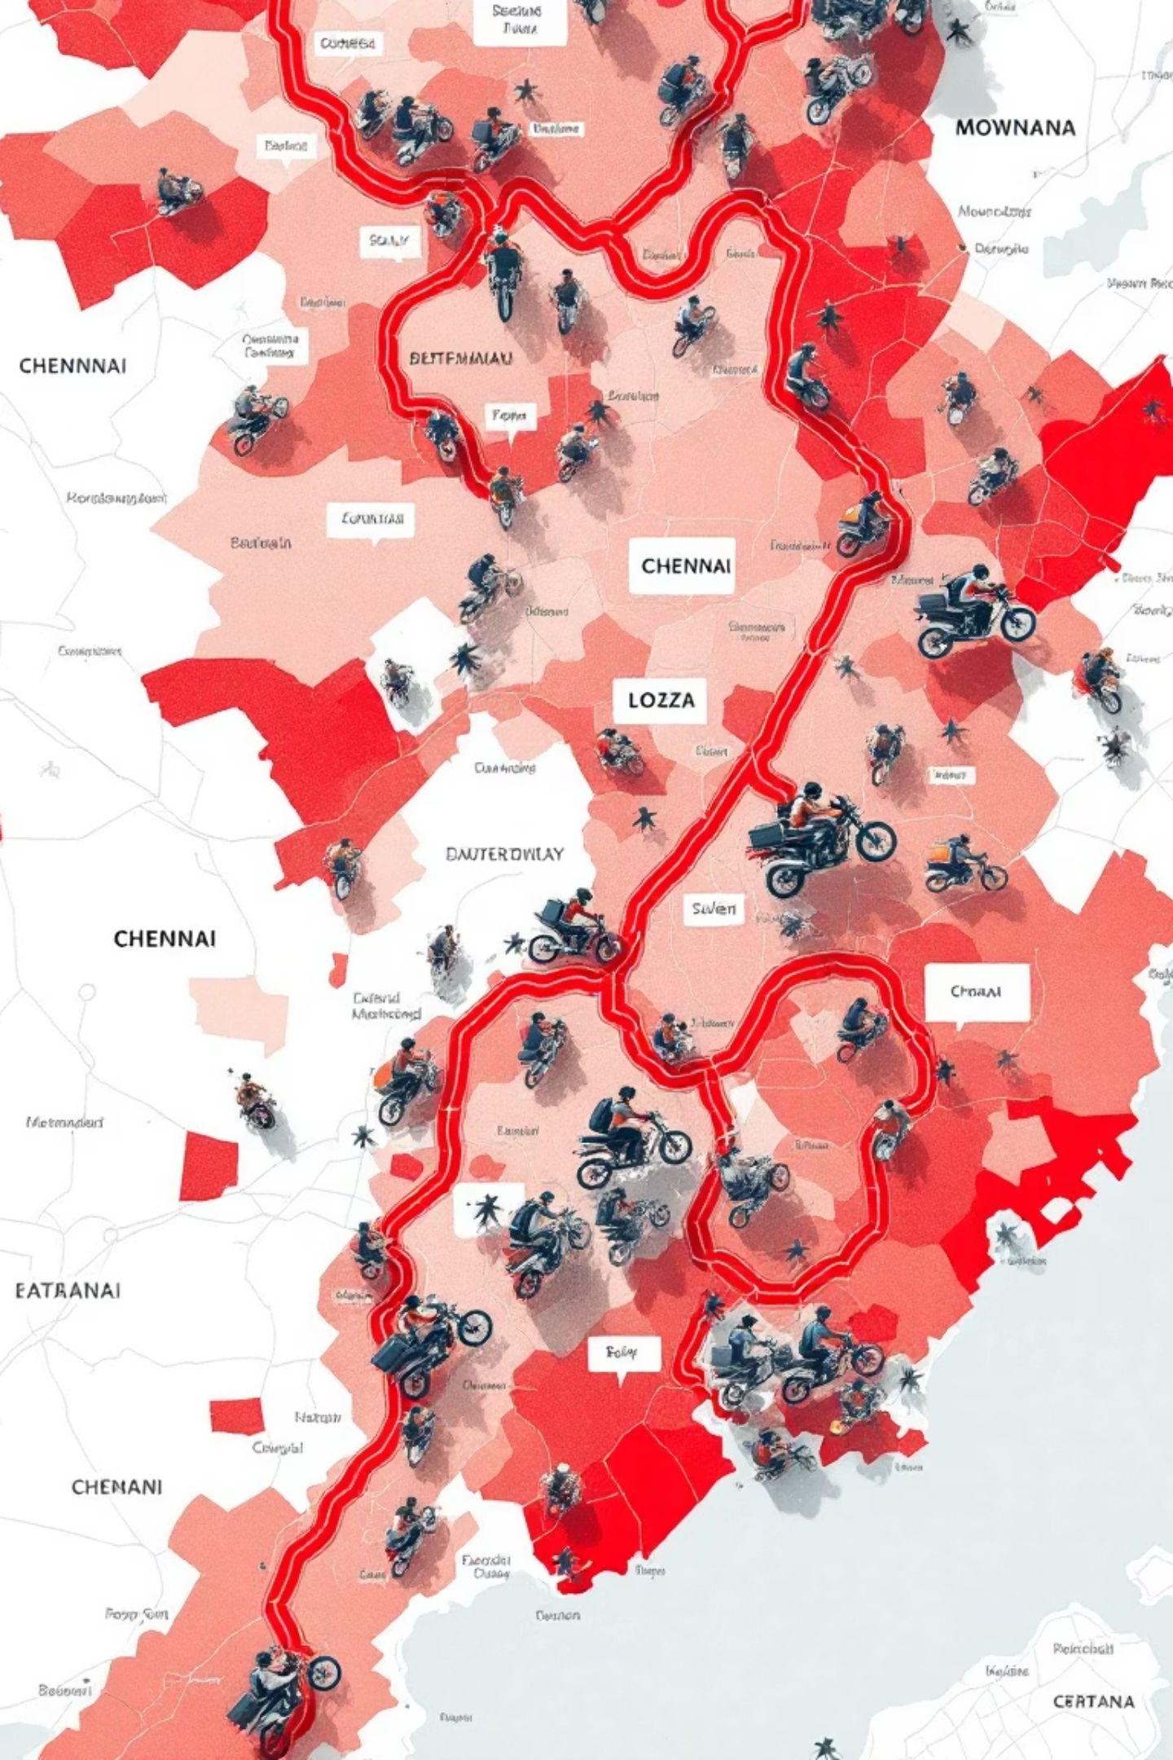
Distance & Fee Dynamics
The Relationship Between Distance and Revenue
Analysis of 78,000 deliveries reveals distinct patterns in how delivery fees correlate with distance traveled, providing crucial insights for pricing optimization.
High-Fee Deliveries
Medium-Fee Deliveries
Average distance: 8.5 km — Premium fees justify longer routes, typically crossing multiple neighborhoods with careful time management.
Average distance: 4.2 km — The sweet spot balancing partner earnings and customer satisfaction within local zones.
Low-Fee Deliveries
Average distance: 1.8 km — Quick neighborhood runs that maximize delivery frequency and partner utilization.

Slide 6
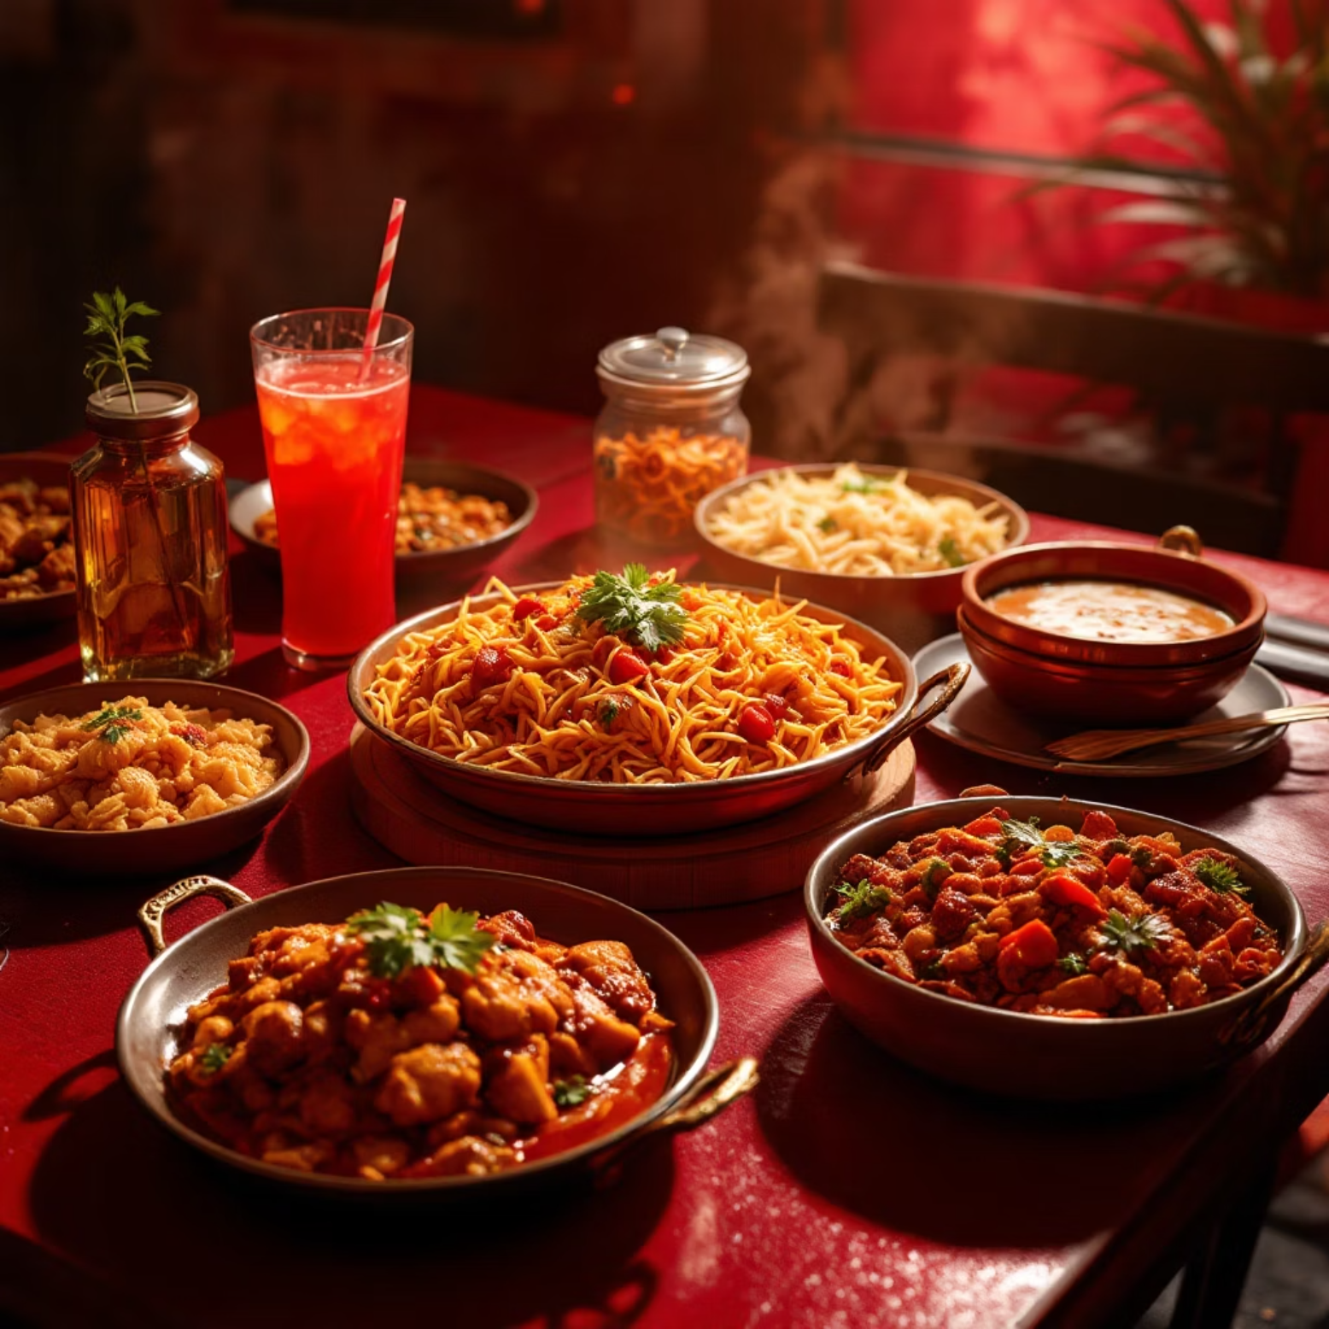



Cuisine & Delivery Status Patterns
What's Driving Orders?
Cuisine preferences and completion rates tell a fascinating story about customer behavior and operational efficiency across different food categories.
Indian Cuisine: 42% of orders
Chinese Cuisine: 28% of orders
Continental & Fast Food: 30%
Highest volume with 92% successful delivery rate — biryani and thali combos lead the charge
Strong performance with 89% completion — fried rice and Manchurian favorites during peak hours
Growing segment with 85% success rate — cancellations slightly higher due to longer prep times

Slide 7
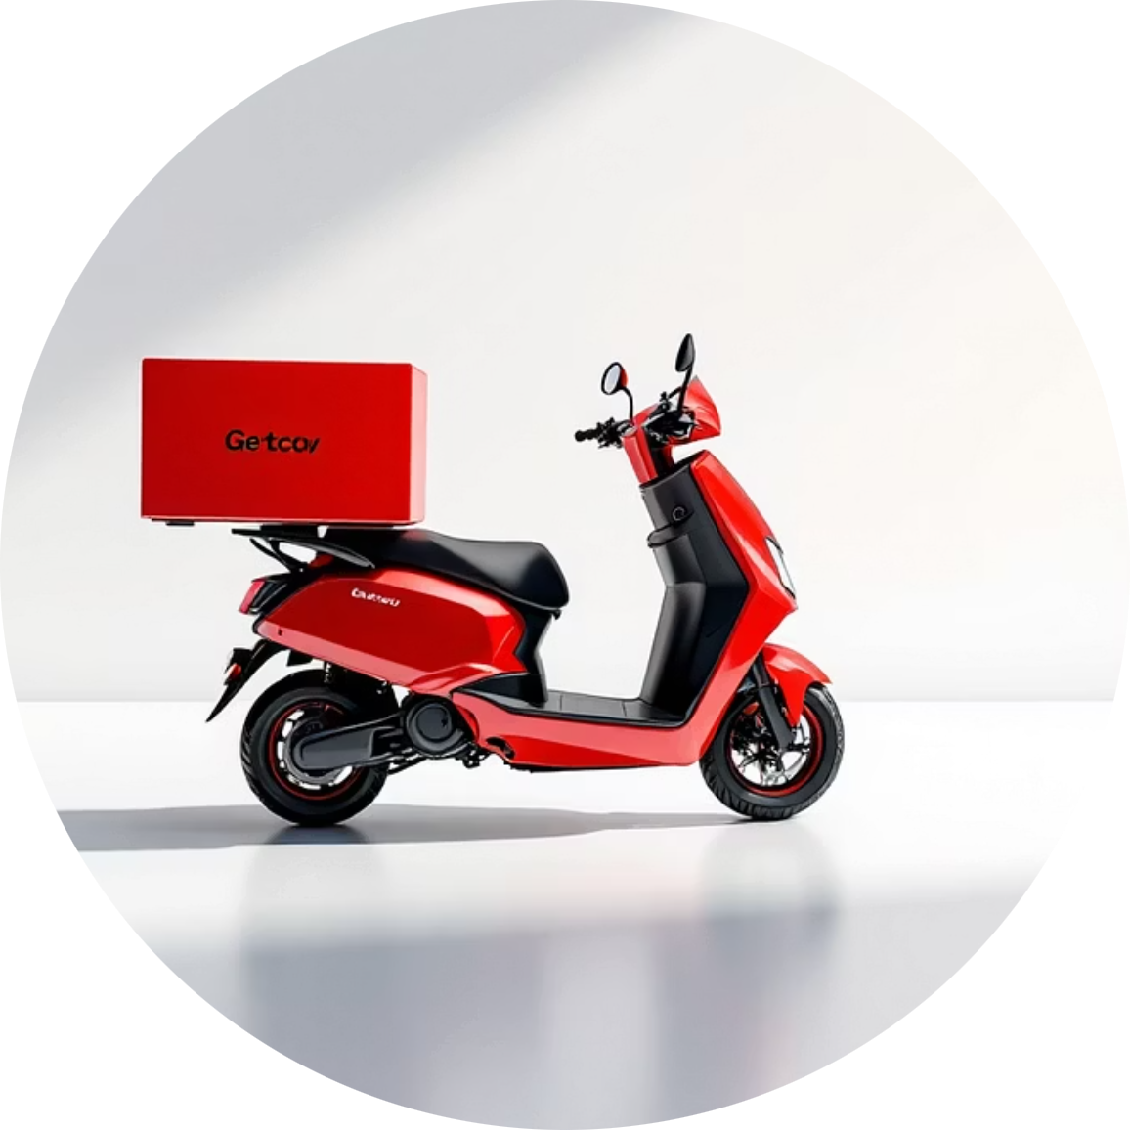
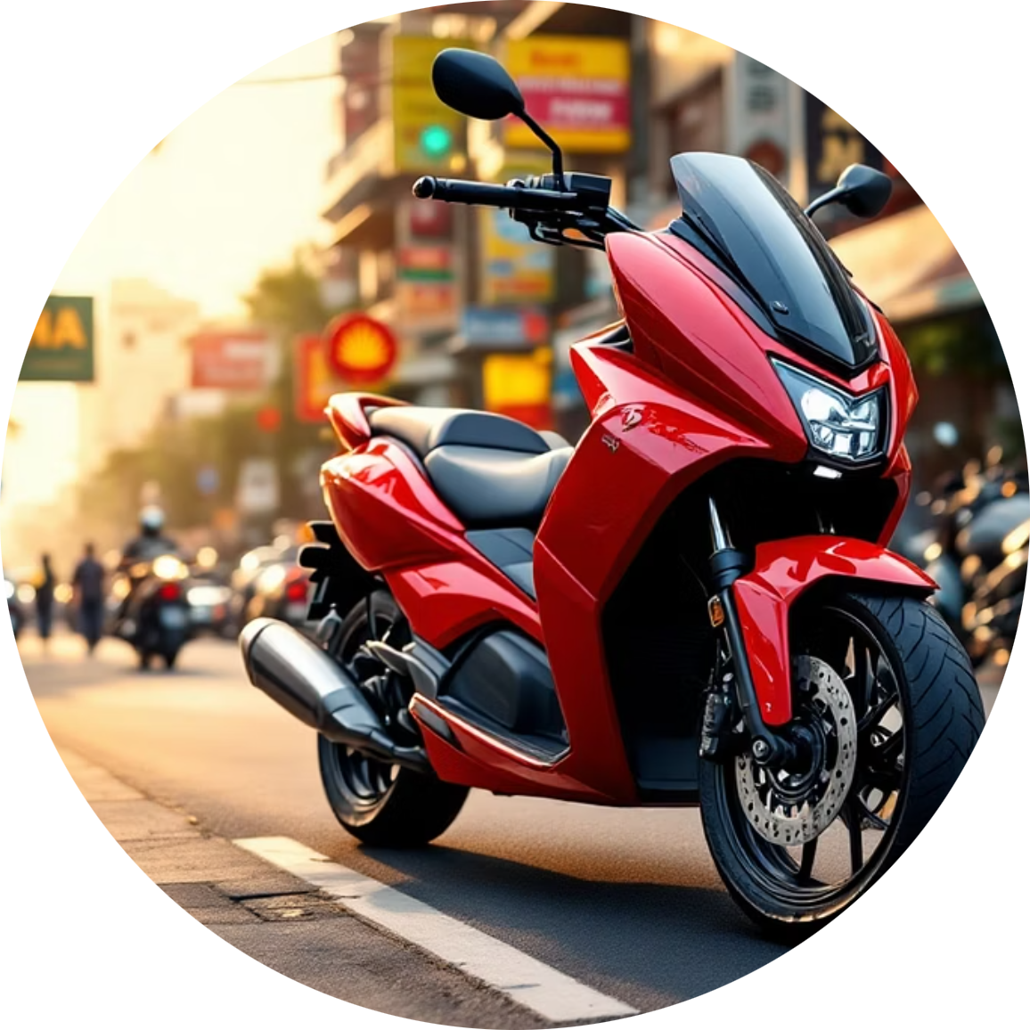
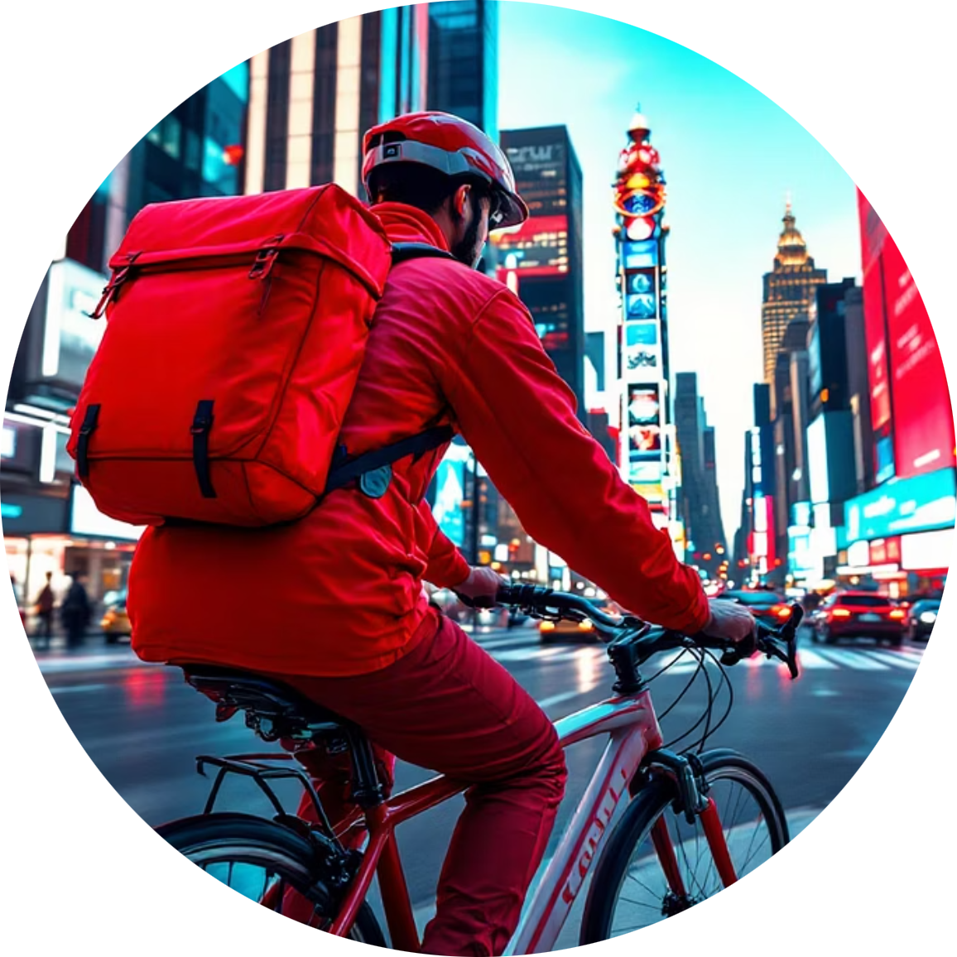
Vehicle Types & Payment Preferences
Motorcycles: 85%
Scooters: 12%
Bicycles: 3%
The workhorse of delivery operations, handling everything from single orders to multiple drop-offs with speed and efficiency.
Growing presence in dense urban areas, offering eco-friendly alternatives with lower operating costs for short distances.
Hyper-local deliveries in congested zones where two-wheelers excel, particularly during lunch rush hours in business districts.
Payment Mode Insights
Cash: 58% — Still the preferred choice in Adyar and surrounding neighborhoods
Digital: 35% — Rapidly growing among younger demographics and tech-savvy users
Card: 7% — Steady but lower adoption, often used for corporate orders

Slide 8
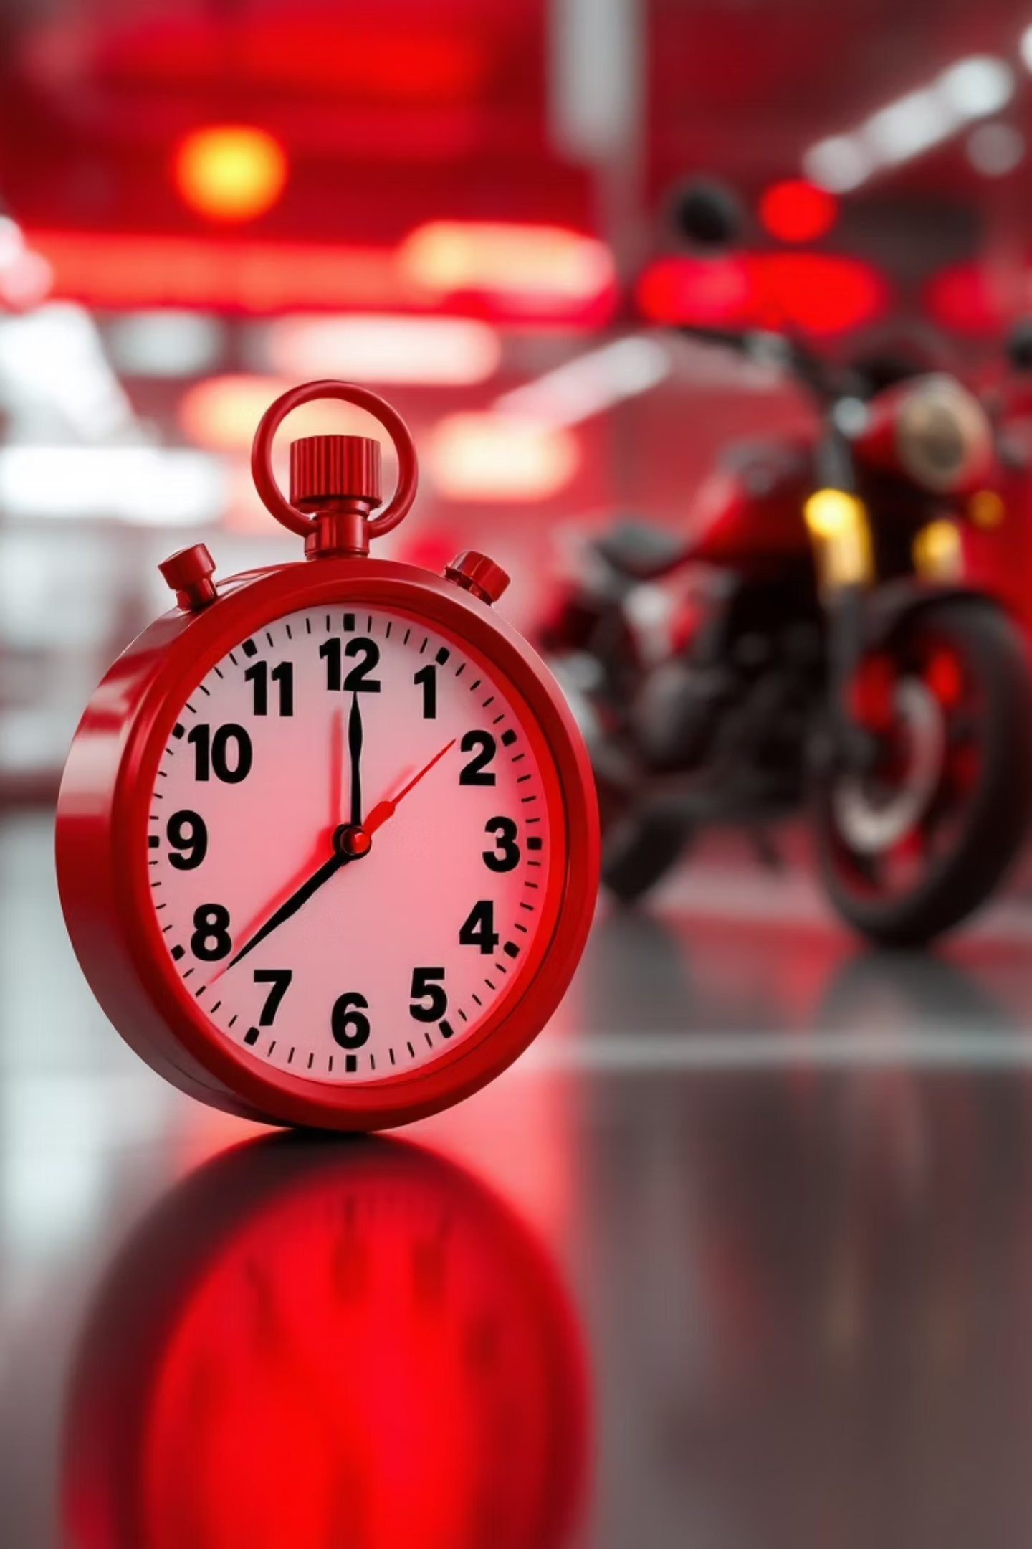

Time, Delays & Efficiency Metrics
Understanding temporal patterns helps optimize route planning and set realistic customer expectations. Our analysis reveals critical insights into delivery performance across different statuses.
1
Completed Orders
Average: 32 minutesEstimated time matches actual delivery with 95% accuracy
2
Delayed Deliveries
Average: 48 minutesWeather and traffic contribute 70% of delays beyond estimates
3
Cancelled Orders
Average estimate: 52 minHigher initial time projections correlate with cancellation likelihood
Key Finding: Orders with estimated delivery times exceeding 45 minutes show 3x higher cancellation rates. Implementing better time prediction models could reduce customer drop-off.

Slide 9
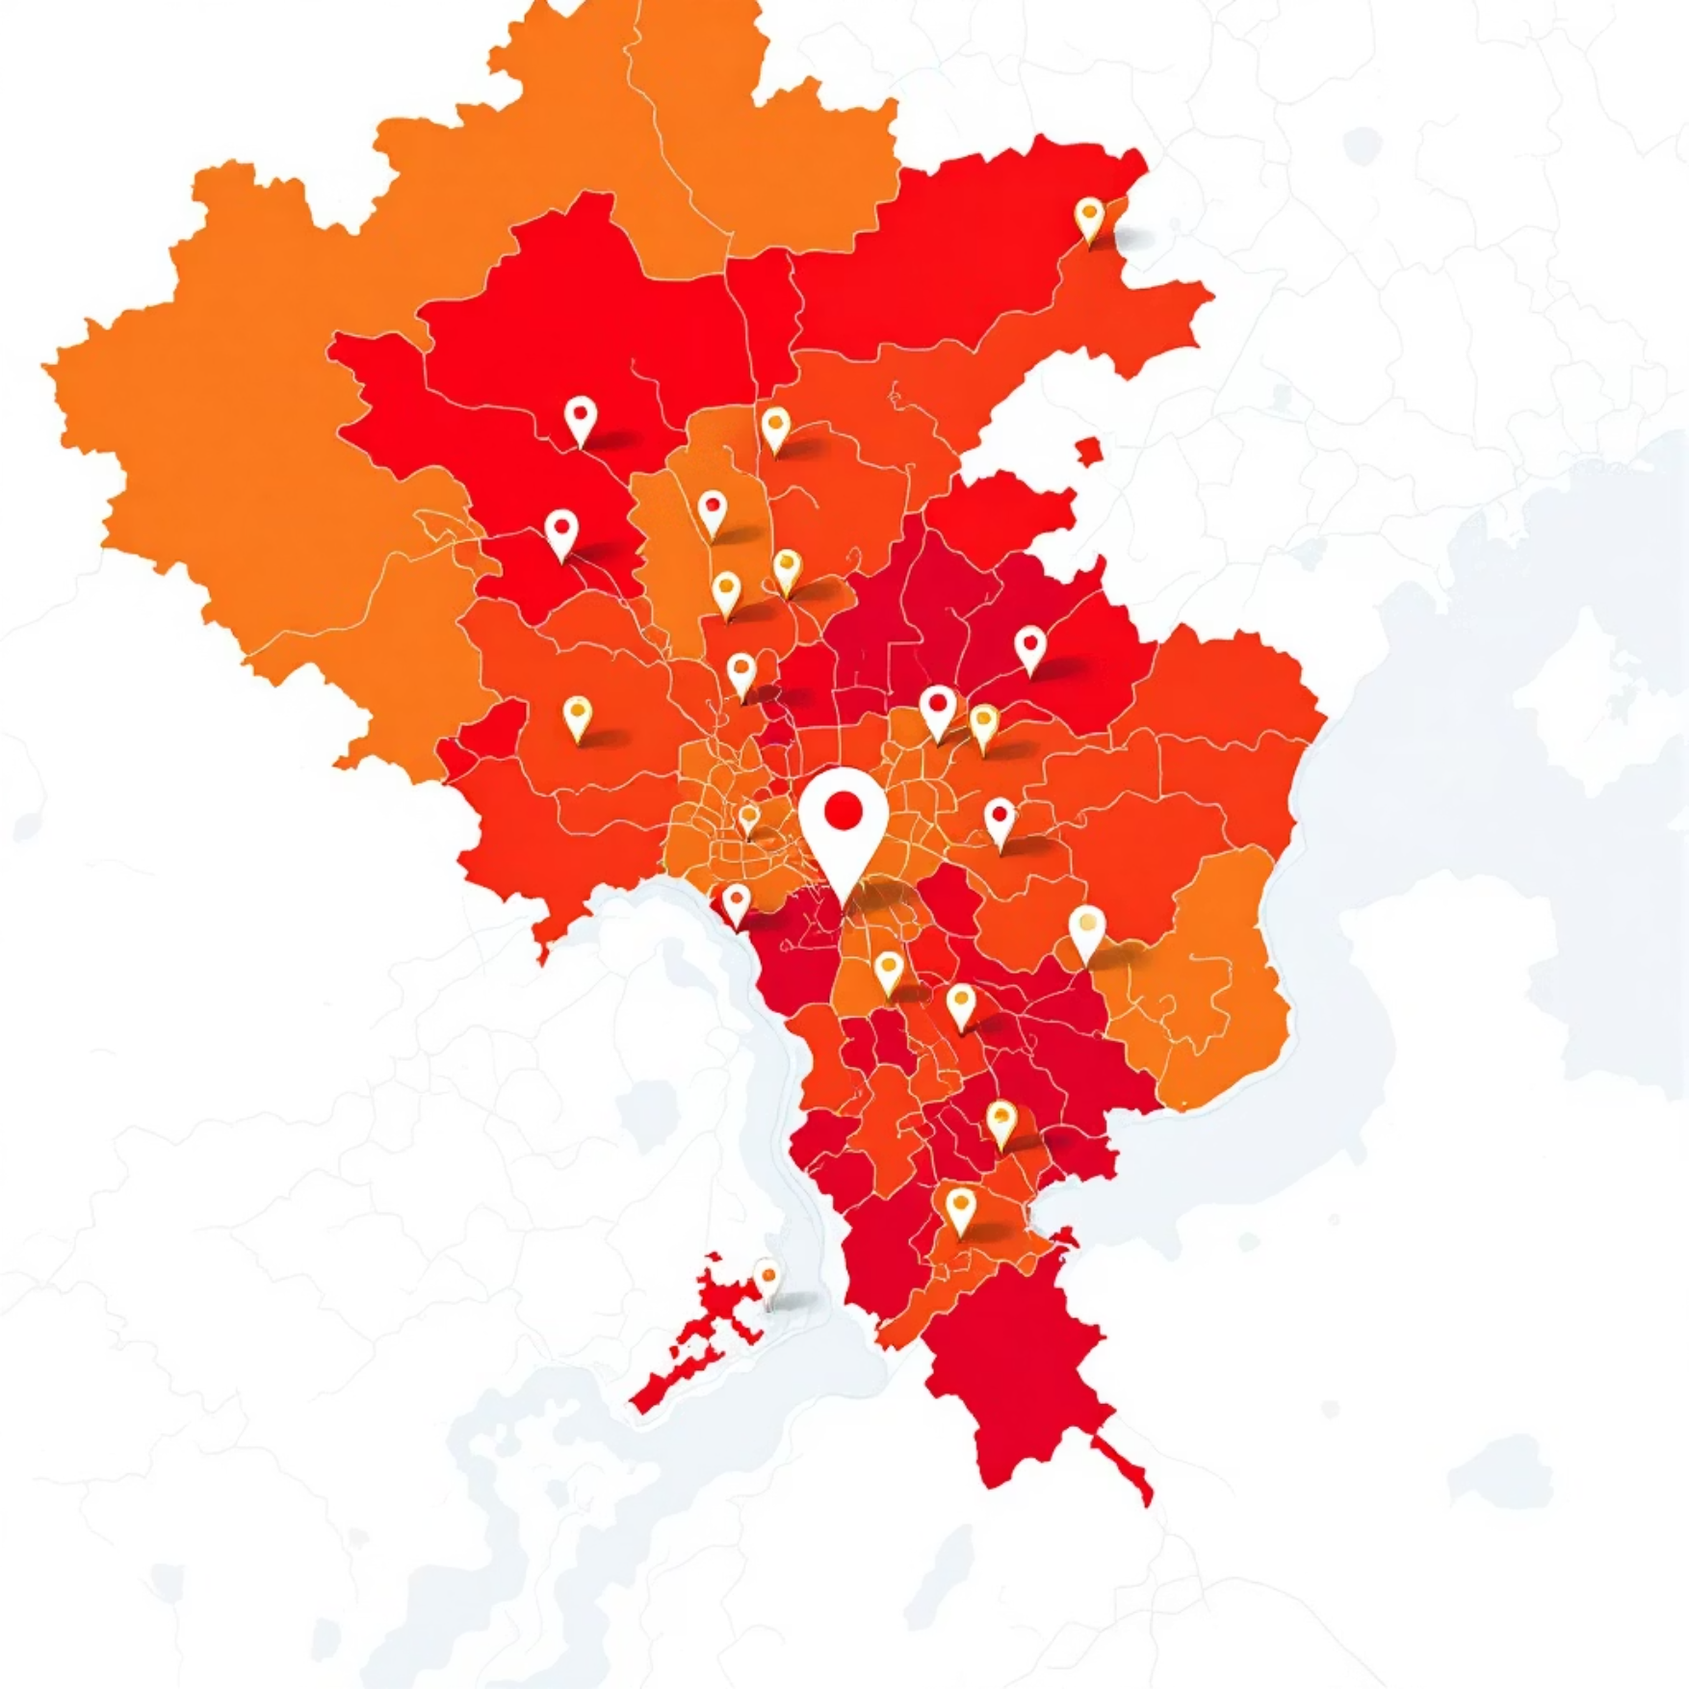
Delivery Issues & Area Performance
Top Performing Areas
Common Delivery Challenges
1
Address Issues
34% — Incomplete or incorrect location details
2
Customer Unavailable
28% — No response at delivery location
3
Restaurant Delays
23% — Food preparation exceeding estimates
4
Weather/Traffic
15% — External factors beyond control
Adyar: 22% of deliveries, 4.3★ rating
Anna Nagar: 18% volume, 4.2★ rating
T. Nagar: 15% volume, 4.1★ rating
Velachery: 12% volume, 4.2★ rating

Slide 10
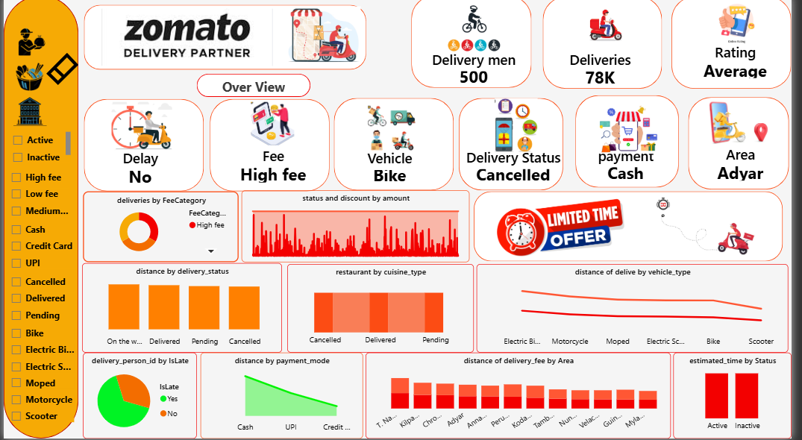
Zomato Delivery Dashboard
1
2
3
Adyar: 22% of deliveries, 4.3★ rating
Anna Nagar: 18% volume, 4.2★ rating
T. Nagar: 15% volume, 4.1★ rating
Velachery: 12% volume, 4.2★ rating

Slide 11



Key Takeaways & Future Roadmap
Performance Insights
Geographic Focus
Technology Impact
92% overall delivery success rate demonstrates operational excellence, with clear opportunities to reduce the 8% through targeted interventions.
Adyar's dominance suggests strong market penetration, while emerging areas like Velachery show growth potential for partner expansion.
Data-driven decision making through Power BI enables proactive issue resolution and continuous improvement across all metrics.
Next Phase Enhancements
Real-Time Tracking
Customer Feedback
Voice-Over
Live partner location updates
Integrated rating analysis
Localized dashboard narration
Let's collaborate! Connect with me on GitHub: github.com/tamiltamil2121v-cloud
Thank you for exploring this data journey. Together, we're making food delivery faster, smarter, and more delightful for everyone.

